Slide 1

Brace for your Next Race
Race conditions in Servlets and Controllers
Giuseppe Trovato
07.10.21

Slide 2
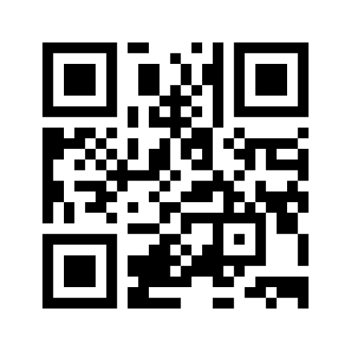
A quick survey to start…
Go to: https://www.menti.com/
Enter the code: 3149 4059
or scan the QR code

Slide 3

Who am I?
Giuseppe Trovato
Security Researcher @ Veracode
Pen-testing & Ethical Hacking
Application Security Management
Background in Java, .NET , PHP development
Size of text box is adjusted to allow more options for types of content.
This example shows how this content works well in this template.
Survey: https://www.menti.com/ use code: 3149 4059

Slide 4

Agenda
This is for a much simpler agenda. The 01 graphic pattern may be removed if not wanted.
Intro to Race Conditions
Live Demo
A Simple Basket Application
Run the Race
Mitigations and Testing effectiveness
Conclusions and Q&A

Slide 5
Intro to Race Conditions /1
A race condition vulnerability occurs when a system that’s designed to handle tasks in a specific sequence is forced to perform two or more operations at the same time. Without proper controls, different processes (or threads) may interfere with each other leading to some unintended behaviour.
Notes:
Ok, one can think that race conditions are a thing of the past, when we were programming on C or C++ … (Ok I know that some people in the audience never did that, how lucky!)
Unfortunately race conditions are not gone, and they can still make a spectacular (and unwanted) appearance today
and we will see an example in action shortly

Slide 6
Intro to Race Conditions /2
A race condition happens when two processes (or threads) access the same shared variable
A bit of History/Folklore
Therac-25
Vending Machines
Redeeming multiple Coupons
Notes:
By their nature race conditions are difficult to debug because:
They happen when the execution is asynchronous
Their occurrence depends on the resources available at the time when the issue happens. Ie: if the server is at low load, it may have enough resources to avoid two threads to share the same variable
They are difficult to reproduce
Therac-25: Interesting to read on internet its story. It is among the most famous bugs in history. In short, two routines shared the same variable to read the data and to handle the keystroke to signal the confirmation of the command. A specific set of characters can be mistake by confirmation and trigger the emission of radiations, with some unfortunate consequences.
https://www.wired.com/2005/11/historys-worst-software-bugs/
Something more mundane: Vending machines:
Pushing two buttons at the same time anyone ?
And coming to the web world: What about using the same coupon more than once ?
https://corneacristian.medium.com/top-25-race-condition-bug-bounty-reports-84f9073bf9e5
https://www.rookout.com/blog/fantastic-bugs-and-how-to-resolve-them-ep2-race-conditions
https://docs.microsoft.com/en-us/troubleshoot/dotnet/visual-basic/race-conditions-deadlocks

Slide 7
Intro to Race Conditions /3
TOCTOU: time-of-check to time-of-use
Checking state followed by action
Session Puzzling
Session variable with multiple uses
Deadlock
CWE-367: Time-of-check Time-of-use (TOCTOU) Race Condition
CWE-366: Race Condition within a Thread
CWE-609: Double-Checked Locking
CWE-488: Exposure of Data Element to Wrong Session
CWE-383: J2EE Bad Practices: Direct Use of Threads
…
https://cwe.mitre.org
Notes:
you may have heard other vulnerabilities (or bugs) that are strictly related to Race conditions and often are called with different names
TOCTOU: Time-of-check to time-of-use
Session Puzzling:
https://owasp.org/www-project-web-security-testing-guide/stable/4-Web_Application_Security_Testing/06-Session_Management_Testing/08-Testing_for_Session_Puzzling
It is mostly discussed in the context of web applications or softwares that include a sort of Session mechanism with some shared variable.
Why not to mention the scariest word I heard during one of my computer programming classes. Deadlock. Yes, race conditions can also cause deadlocks if the variable that is used to regulate some activity is accessed improperly

Slide 8
Live Demo
Coupons anyone ?

Slide 9
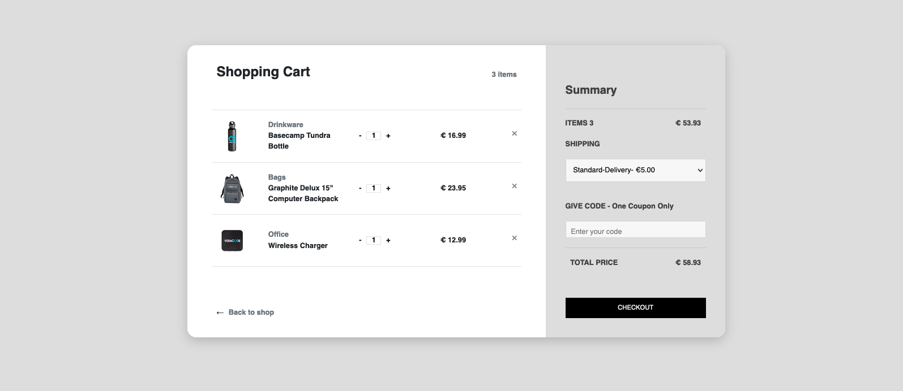
Live Demo - A Simple Basket Application
https://lab.🤕💥🏎.ws/

Slide 10
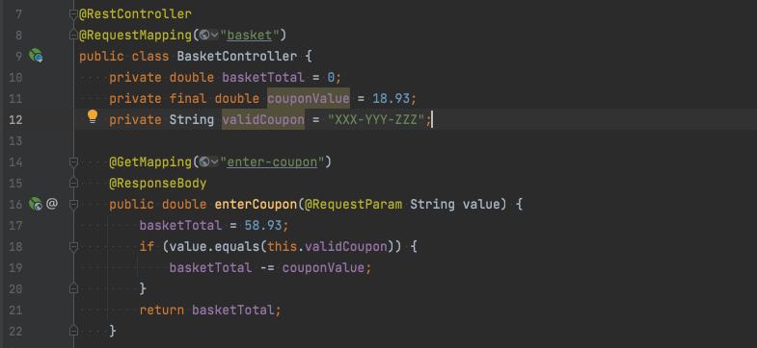
Live Demo - A Simple Basket Application

Slide 11
Guess how much we pay…
Go to: https://www.menti.com/
Enter the code: 3149 4059
or scan the QR code
Notes:
Ok, one can think that race conditions are a thing of the past, when we were programming on C or C++ … (Ok I know that some people in the audience never did that, how lucky!)
Unfortunately race conditions are not gone, and they can still make a spectacular (and unwanted) appearance today
and we will see an example in action shortly

Slide 12
Live Demo
€ 40.00 when everything goes right
€ 21.07 when two threads apply the coupon twice
But anything below € 40.00 is possible in our scenario

Slide 13
Live Demo - A Simple Basket Application
thread1
thread2
58.93
58.93
40.00
40.00
21.07

Slide 14
Live Demo – Some Tools
Burp Suite
A Java platform to perform Software Testing
Includes a Proxy Tool
Turbo Intruder
Burp plugin
Useful for sending large numbers of HTTP requests

Slide 15
Live Demo – Run the Race
Request interception & Response review
Invalid coupon
Valid coupon
Brief description of the Turbo Intruder configuration
Launching the Load test

Slide 16
Some Mitigations
Avoid storing values in Member Fields in Controllers / Servlets
J2EE: Don’t implement your own thread management in a Web Application
Manually Handling the Critical section
java.util.concurrent.locks.ReentrantLock (since Java 1.5)
Reentrant mutual esclusion Lock
Implicit monitor lock accessed using syncronized
Don’t forget to unlock
Using synchronized on the method
Non optimal in our scenario because the same variable can be read in different locations
Implementing a Semaphore
Don’t forget to release

Slide 17
Some Mitigations
Scope Annotation
Bean scopes
Singleton
Same cached object returned
Prototype
A difference instance is returned at every invocation
WebApplicationContexts
SCOPE_REQUEST
Instantiated when a request accesses the bean
SCOPE_SESSION
Instantiated when the session accesses it
Probably not optimal for our use case (the object is reused for subsequent request in the same session)
SCOPE_APPLICATION
Shared in the same ServletContext
Reused for subsequent requests in the same ServletContext
Notes:
Note that A controller is a Bean

Slide 18
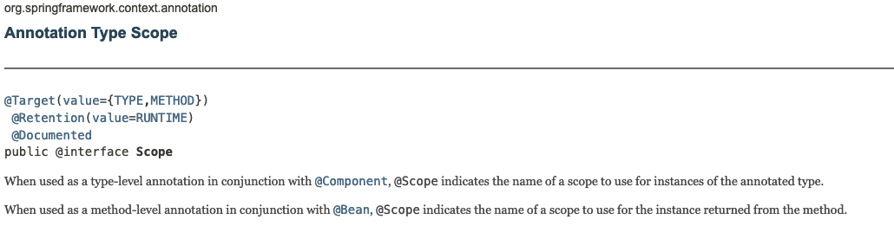

Type-level != Method-Level
Notes:
Note that A controller is a Bean

Slide 19
Thank You
Giuseppe Trovato
https://github.com/JoeFound
gtrovato at veracode.com
@otavorteppesuig on Twitter

